Slide 1




IT-Experts Foundation
Code, For Change The World
IT-Experts Foundation
itexperts127001@gmail.com
Code, For Change The World
@_itexperts_

Slide 2


Java
Q1: Data types in Java?
Q2: What is Java Literals?
Q3: What is Type Casting & Outer casting in Java?
Q4: Identifiers and Naming Conventions?
IT-Experts Foundation
itexperts127001@gmail.com
Code, For Change The World
@_itexperts_

Slide 3
-> Java
Data types specify the different sizes and values that can be stored in the variable.
In Java, Two types of Data types are Present :
Primitive Data type (Static & fixed).
Non Primitive Data type. (Dynamic & non fixed).
Some Examples:
int num = 5;
float floatnum = 5.99f;
double doublenum = 1.28;
char alphabet = 'D';
boolean booleanNum = true;
String words = "Hello Rajat";
IT-Experts Foundation
itexperts127001@gmail.com
Code, For Change The World
@_itexperts_

Slide 4
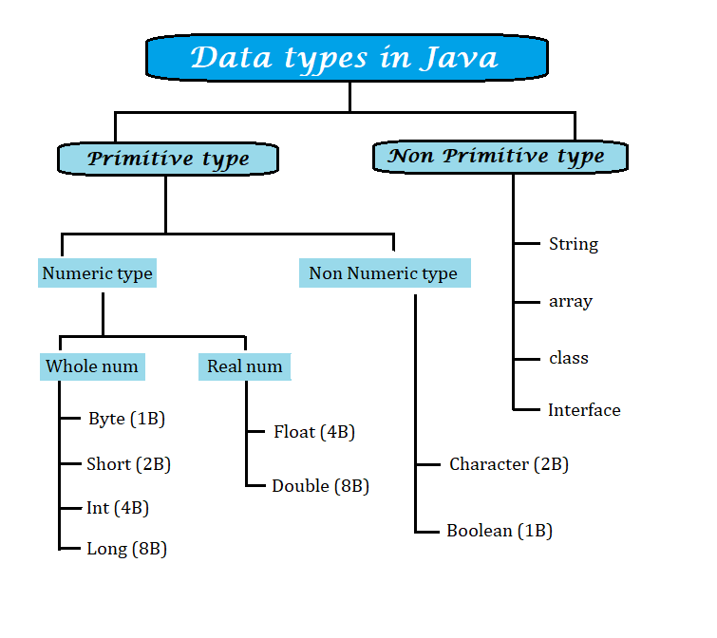
-> Java Data Types
→ So we will Now Write Our Second Program in Java.
IT-Experts Foundation
itexperts127001@gmail.com
Code, For Change The World
@_itexperts_

Slide 5
-> Java Literals
Constant in C language are Known as Literals in Java.
We can also say that a fixed value variable is a literal, for example:
int octal = 0144; //0 denotes octal & 0x denotes hexadecimal.
Now we will discuss examples on Primitive and Non Primitive data type:
Primitive data type: int a = 10, b = 50;
String str = “Kamran”;
Non Primitive data type: Student obj = new Student();
String str = new String(“Kamran”);
“new” Keyword is used for dynamic allocation of memory in Java.
Note: String is a Special data type in Java which is a Non primitive data type
having some primitive characteristics.
IT-Experts Foundation
itexperts127001@gmail.com
Code, For Change The World
@_itexperts_

Slide 6
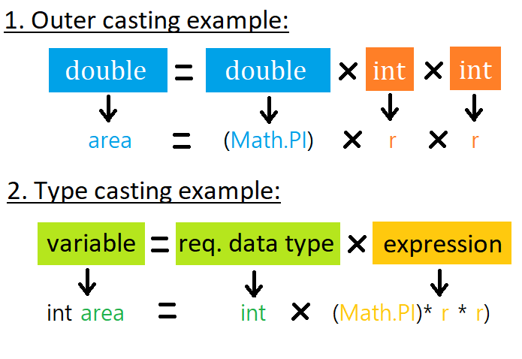
-> Naming Conventions & Casting
In Java Identifiers can have letters, digit & two Special symbol.
Underscore ( _ ).
Dollar ( $ )
Java Support full length name and the name must reflect the actual role of identifier.
Always begin with alphabet and classes name first alphabet is Capital.
for Example: InputStreamReader , Scanner.
Casting: Two types –
Lower value to higher value data type
Higher value to lower value data type
IT-Experts Foundation
itexperts127001@gmail.com
Code, For Change The World
@_itexperts_

Slide 7
-> Java Data Types
IT-Experts Foundation
itexperts127001@gmail.com
Code, For Change The World
@_itexperts_

Slide 8

Doubts ?
Any Questions Feel
Free to Ask
itexperts127001@gmail.com
@_itexperts_
IT-Experts Foundation
itexperts127001@gmail.com
Code, For Change The World
@_itexperts_

Slide 9





Like
Share
Thank You
Happy Coding!!!
IT-Experts Foundation
itexperts127001@gmail.com
Code, For Change The World
@_itexperts_

